Slide 1
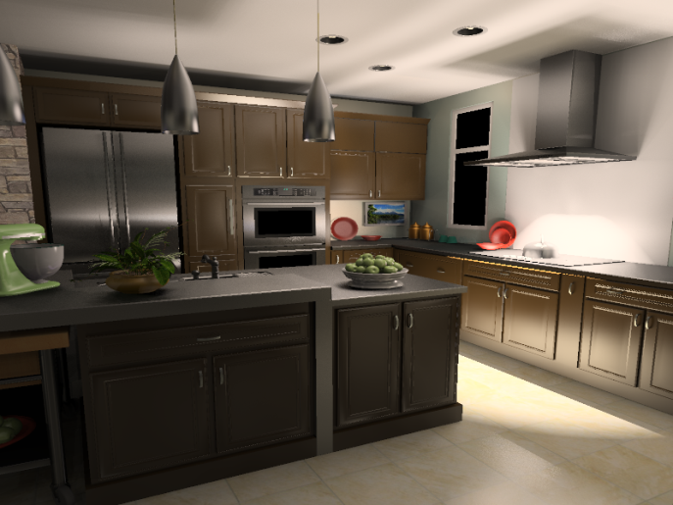
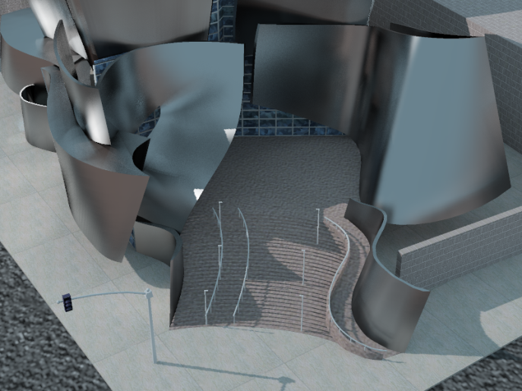
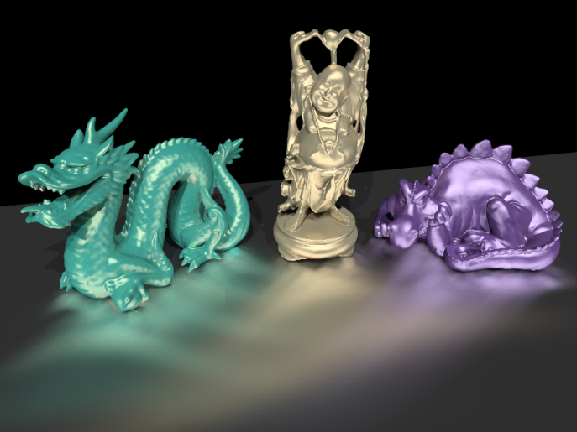
Virtual Spherical Lights for Many-Light Rendering of Glossy Scenes
Miloš Hašan
Jaroslav Křivánek *
Bruce Walter
Kavita Bala
Cornell University * Charles University in Prague

Slide 2
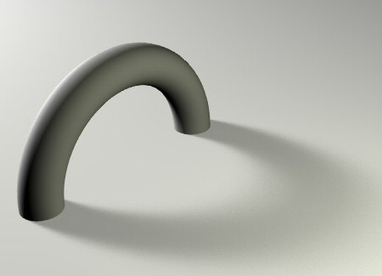
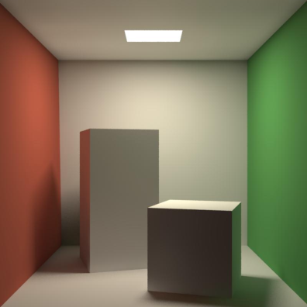
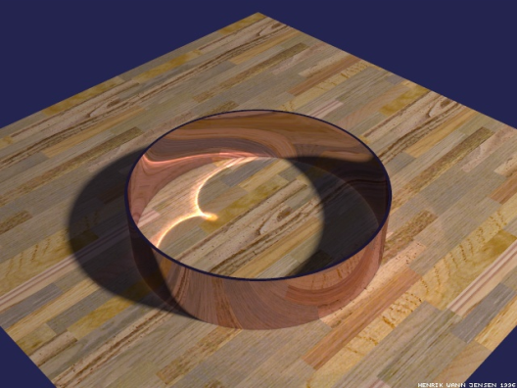
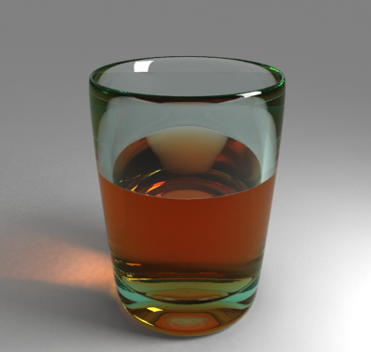
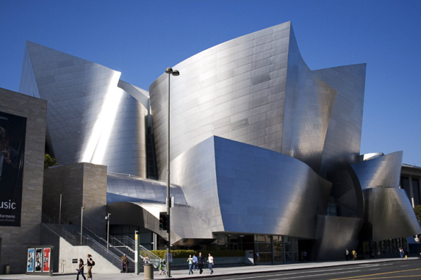
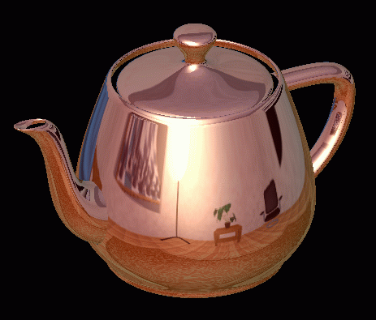
Global Illumination Effects
Soft shadows
Color bleeding
Caustics
Mirror reflection
Refraction
Glossy inter-reflection
Monte Carlo can handle them all… but is very slow
Notes:
We’re dealing with a long standing problem of CG: computing global illumination efficiently. Depending on the scene properties, GI produces different illumination effects but we’re specifically focusing on light inter-reflections on glossy surfaces. Monte Caro methods, such as PT, are general enough to handle all these effects, but can take long time to converge, especially in the scenes that we’re focusing on.

Slide 3
Faster algorithms exist…
Soft shadows
Color bleeding
Caustics
Mirror reflection
Refraction
Glossy inter-reflection
But no satisfying solution for glossy inter-reflection
Notes:
Some fast specialized algorithms exist but there is no satisfying solution for glossy inter-reflections.

Slide 4
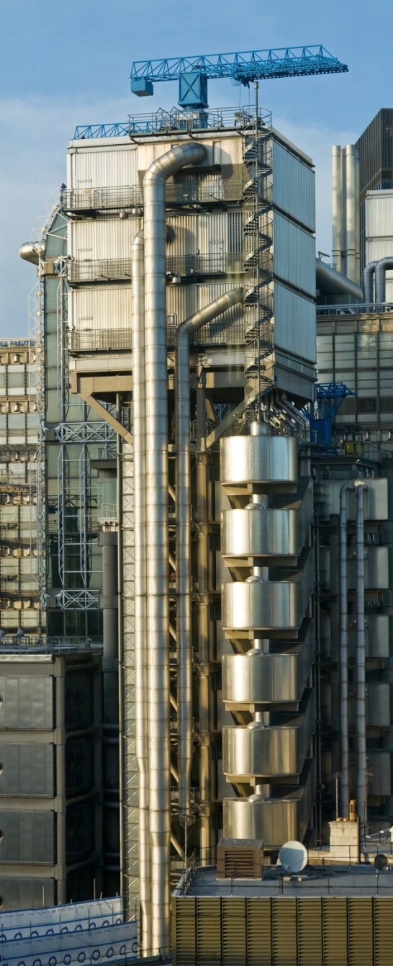
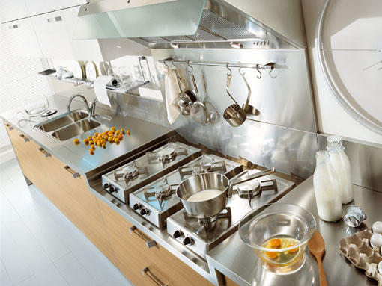
Glossy Inter-reflections
Notes:
This is the kind of images that we would like to render. Indeed, their appearance is completely dominated by glossy inter-reflections.

Slide 5
Previous Work
Unbiased methods
  (Bidirectional) Path tracing
  [Kajiya 1985, Lafortune et al. 1993]
  Metropolis Light Transport
  [Veach and Guibas 1997]
Biased methods
  Photon Mapping
  [Jensen 2001]
  Radiance caching
  [Křivánek 2005]
Notes:
Unbiased GI methods converge slowly since they have hard times finding important paths when dealing with glossy scenes.
Photon mapping is the most well known example of an biased GI method. However, it does not perform very well in glossy scene either: huge number of photons is required and final gathering is a bottleneck.
Final gathering can be accelerated with interpolation-based approaches such as radiance caching, but their assumptions about illumination smoothness is often invalid.

Slide 6
Previous Work – Instant Radiosity
Virtual Point Lights (VPLs)
Very efficient in mostly diffuse scenes
  Real-time global illumination
  [Wald et al. 2002, Segovia et al. 2006, 2007, Laine et al. 2007, Ritschel et al. 2008, Dong et al. 2009]
Scalability to many lights
[Walter et al. 2005, 2006, Hašan et al. 2007]
Notes:
Instant radiosity is a GI method that has gained a lot of attention recently. The idea is to convert all the illumination into a set of VPLs. Since only a few VPLs are sufficient to get a believable approximation of GI, this algorithm has been the basis of many recent real-time GI methods.
On the other hand, with many VPLs, instant radiosity can produce very high quality images – that’s why some work has addressed the problem of scalability with many lights.
Due to it’s efficiency, we chose IR as the basis of our approach to the glossy inter-reflection problem.

Slide 7
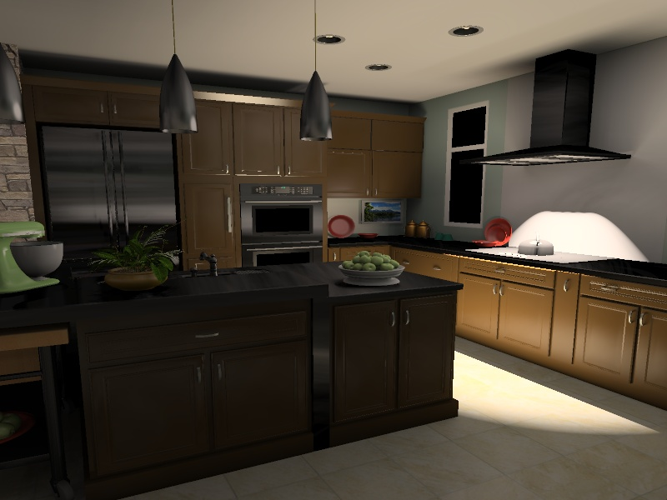
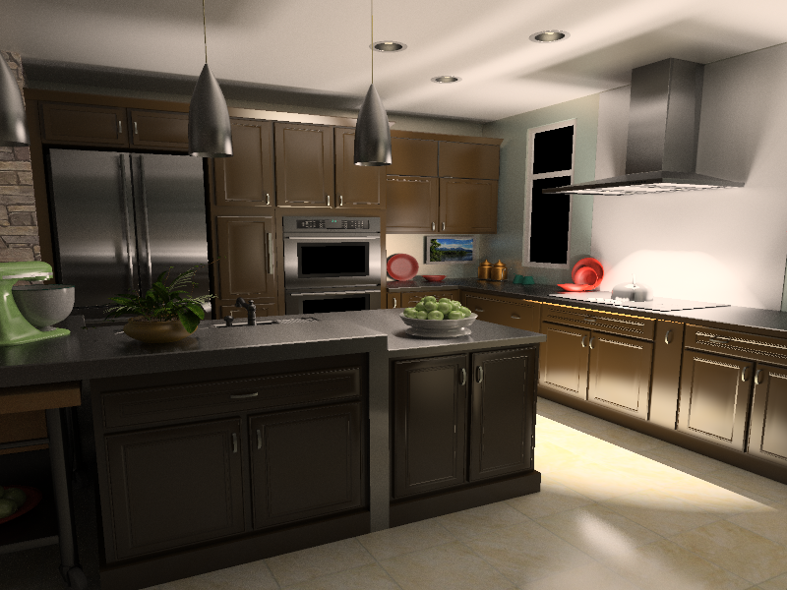
Limitations of Instant Radiosity
So far: Instant radiosity & Glossy inter-reflections
Instant radiosity: illumination loss
Reference
Notes:
However, it has been a common knowledge that instant radiosity does not work well in glossy scenes. The reason is that in order to prevent image artifacts, instant radiosity completely ignores some complex parts of light transport, which results in serious illumination loss on glossy surfaces, as you can see on the range hood or the counter.

Slide 8
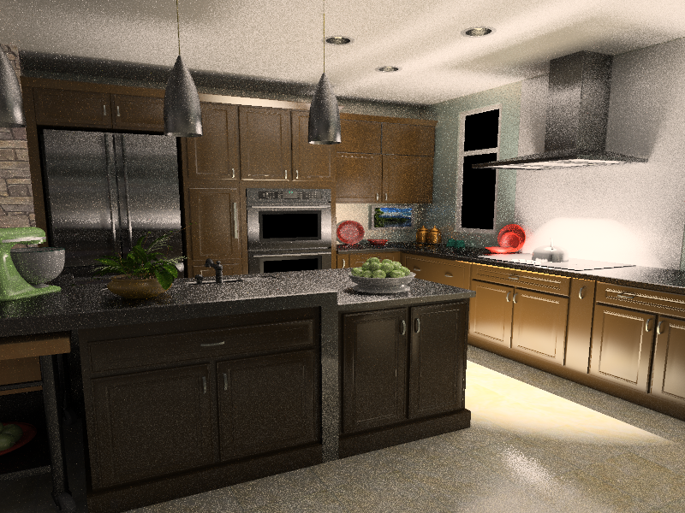
Previous Work on Compensation
Compute the missing components by path tracing [Kollig and Keller 2004]
Glossy scenes
  As slow as path-tracing everything
Path traced compensation: 3.5 hours
Reference
Notes:
The illumination loss problem hasn’t been extensively discussed in previous work with the exception of the paper by Kollig and Keller, who propose to compensate for the missing energy by path tracing. Unfortunately, in glossy scenes, their compensation methods is nearly as expensive as path tracing the entire image.

Slide 9

Our Method
New type of light: Virtual Spherical Light
Our method: 4 minutes
Reference
Notes:
Our idea, on the other hand, is to prevent the illumination loss in the first place, rather than trying t compensate for it. We achieve this by introducing a new type of light, the VSL, that overcomes some of the problems of VPLs.
With this new type of light, we are able to render images very similar to the reference yet in much shorter time.

Slide 10
Outline
Problems with Virtual Point Lights (VPLs)
Our solution: Virtual Spherical Lights (VSLs)
Implementation
Results

Slide 11
Outline
Problems with Virtual Point Lights (VPLs)
Our solution: Virtual Spherical Lights (VSLs)
Implementation
Results

Slide 12
Instant Radiosity
STEP 1
  Trace paths from the light

Slide 13
Instant Radiosity
STEP 1
  Trace paths from the light
  Treat path vertices as Virtual Point Lights (VPLs)

Slide 14
Instant Radiosity
STEP 1
  Trace paths from the light
  Treat path vertices as Virtual Point Lights (VPLs)
STEP 2
  Render scene with VPLs

Slide 15
Emission Distribution of a VPL
Cosine-weighted BRDF lobe at the VPL location
Glossy
Diffuse

Slide 16
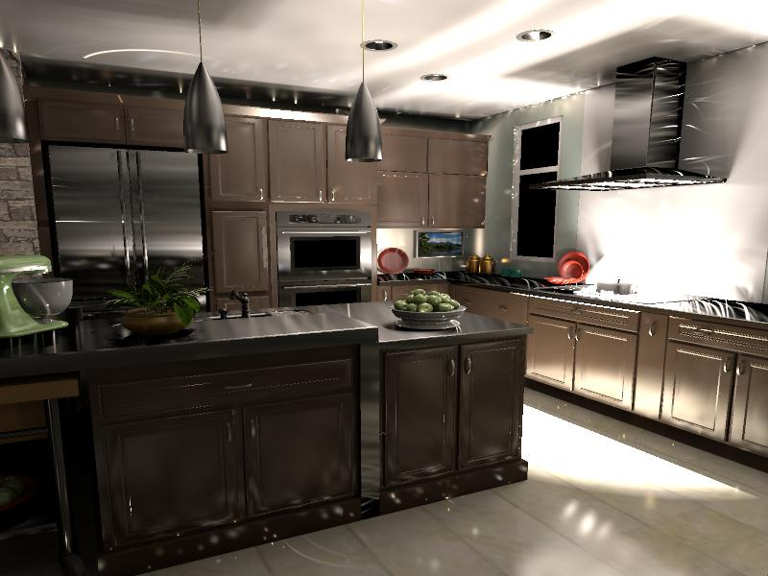
Glossy VPL Emission: Illumination Spikes
Common solution:
Only diffuse BRDF at light location
Notes:
If you render the scene with VPLs defined this way your will get an image with a lot of splotches. Each splotch corresponds to the spike in the emission distribution of a single VPL. For example, the streak on the ceiling is caused by a VPL located on a highly anisotropic glossy surface.
The common solution in instant radiosity is to ignore the glossy component of the BRDF at the light location which produces VPLs with very uniform emission distribution.

Slide 17
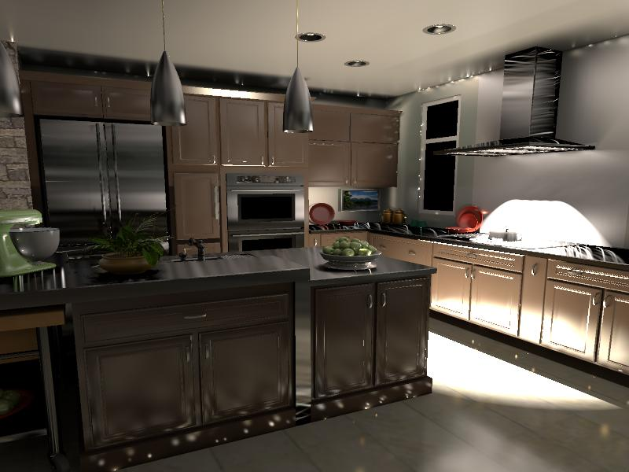
Remaining Spikes

Slide 18
Remaining Spikes
VPL contribution =
VPL power . BRDF(x) . cos(x) . 1 / || p – x ||²
As || p – x || → 0, VSL contribution → ∞
p
spike!
x
x
Common solution: Clamp VPL contributions

Slide 19
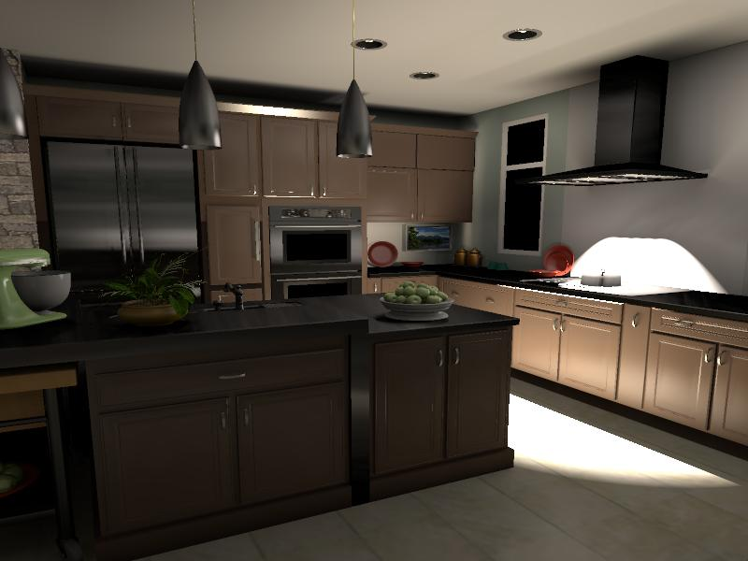
Instant Radiosity: The Practical Version
Clamping and diffuse-only VPLs:
Illumination is lost!

Slide 20
Comparison
Clamped VPLs: Illumination loss
Path tracing: Slow

Slide 21
Outline
Problems with Virtual Point Lights (VPLs)
Our solution: Virtual Spherical Lights (VSLs)
Implementation
Results

Slide 22
Motivation
VPLs: image splotches due to
  Spikes in the VPL emission distibution
  1 / || p – x || term
Idea
  Spread VPL energy over a finite surface
  Compute contribution as solid angle integral

Slide 23
VPL to VSL
Non-zero radius (r)
Integration over
non-zero solid angle
p
l
Ω
x
Notes:
More specifically, we well spread the light energy over the surfaces inside the sphere of radius r centered at the light position p. And the contribution of the light will be computed as an integral over the solid angle subtended by the sphere.

Slide 24
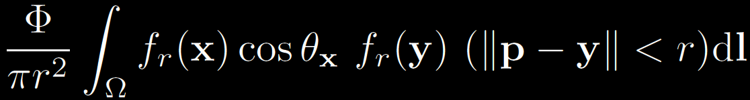
Light Contribution
Non-zero radius (r)
Integration over
non-zero solid angle
p
y
l
Ω
x
Notes:
Let’s write down the formula for the contribution of such a light to the surface point x. We have the integration over the solid angle. The integrand is a product of the following terms: the cosine weighted BRDF at the surface, next, the BRDF at the point y n the vicinity of the light location. Finally, we have an indicator term that is zero for all the directions that correspond to surface point y outside the sphere. We normalize the integration by the expected surface area inside the sphere, pi*r^2, and multiply by the light flux.
To avoid this indicator term, we could define the light contribution as an integral over a disk area. Unfortunately, doing that re-introduces the infamous 1/dist^2 term and produces bad results (we tried it).

Slide 25
Light Contribution
Non-zero radius (r)
Integration over
non-zero solid angle
p
y
l
Ω
Problem: Finding y requires ray-tracing
x
Notes:
Unfortunately, this formulation requires finding the point y for all directions l inside the cone, which required ray tracing. This is clearly not feasible.

Slide 26
Simplifying Assumptions
Non-zero radius (r)
Integration over
non-zero solid angle
p
y
Constant in Ω:
  Visibility
  Surface normal
  Light BRDF
l
Ω
x
Taken from p, the light location
Notes:
To produce a computationally convenient approximation to the previous formula, we make the following simplifying assumptions. We assume that the visibility, the surface normal and the BRDF are constant inside the sphere. And we take them from the light location p.

Slide 27

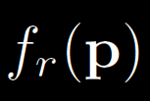

Light Contribution Updated
Non-zero radius (r)
Integration over
non-zero solid angle
p
l
Ω
x
Notes:
With these assumptions, we can write a formula for the contribution of a VSL:

Slide 28
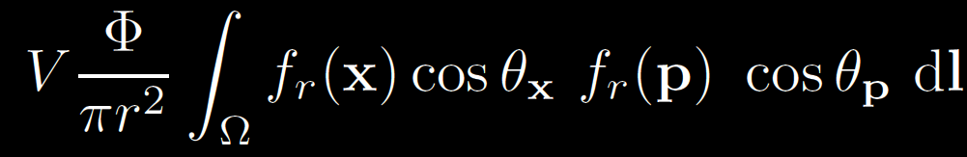
Virtual Spherical Light
All inputs taken from x and p
  Local computation
Same interface as any other light
  Can be implemented in a GPU shader
Visibility factored from the integration
  Can use shadow maps

Slide 29
Outline
Problems with Virtual Point Lights (VPLs)
Our solution: Virtual Spherical Lights (VSLs)
Implementation
Results

Slide 30
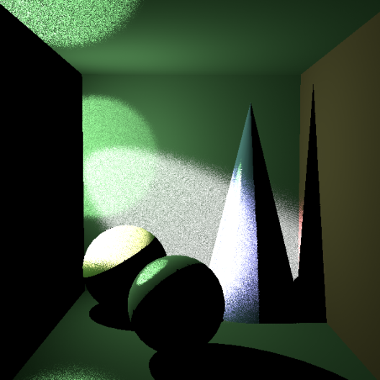
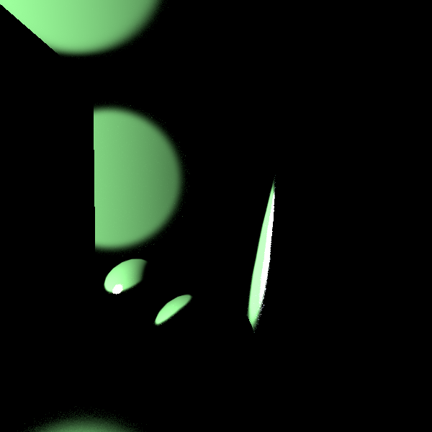
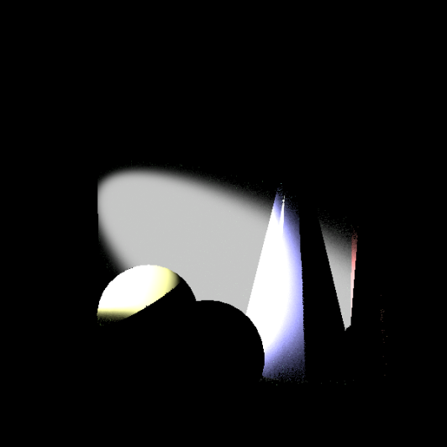
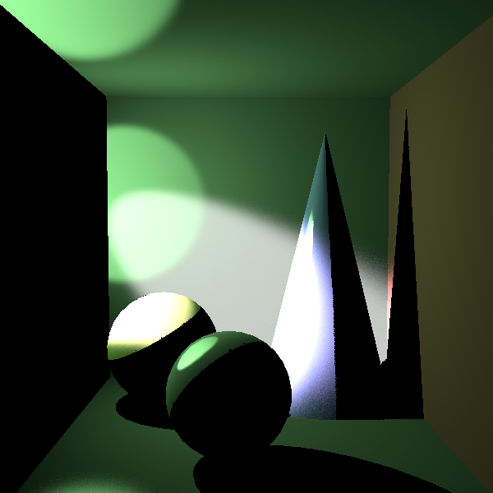
Computing the VSL integral
Monte Carlo quadrature
Cone sampling
BRDF 1 sampling
BRDF 2 sampling
Combined sampling

Slide 31
Implementation
Matrix row-column sampling [Hašan et al. 2007]
  Shadow mapping for visibility
  VSL integral evaluated in a GPU shader
Need more lights than in diffuse scenes
VSL radius proportional to local VSL density
  determined by k-NN queries

Slide 32
Outline
Problems with Virtual Point Lights (VPLs)
Our solution: Virtual Spherical Lights (VSLs)
Implementation
Results

Slide 33
Results: Kitchen
Most of the scene lit indirectly
Many materials glossy and anisotropic
Path tracing:
316 hours (8 cores)
Clamped VPLs
34 sec (GPU) – 2000 lights
New VSLs:
4 min 4 sec (GPU) – 10000 lights

Slide 34
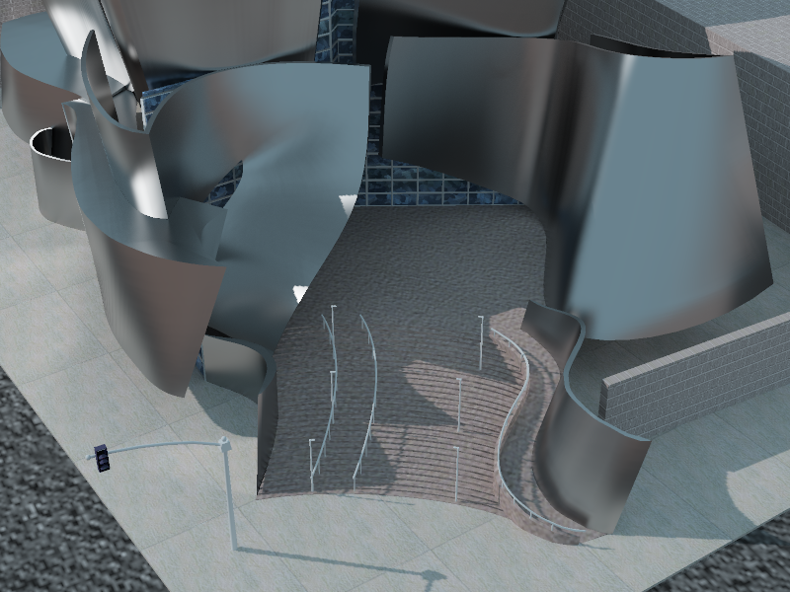
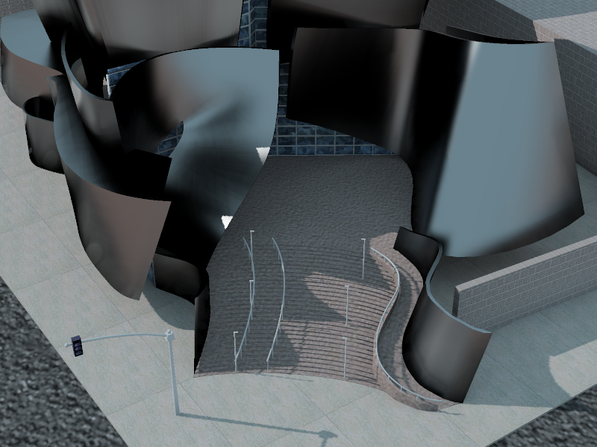
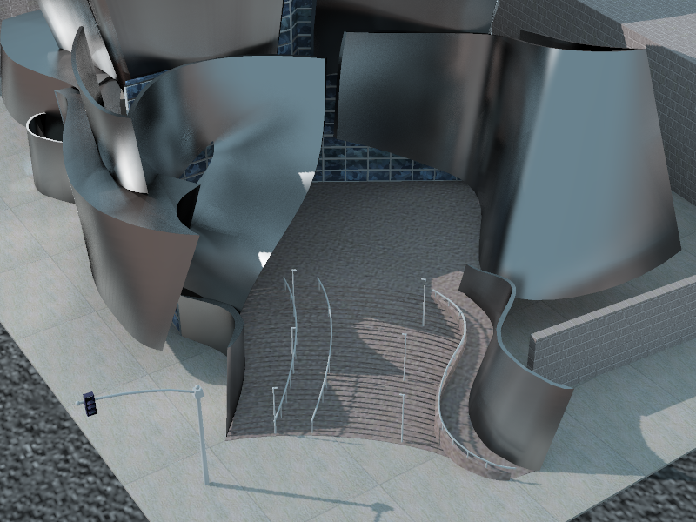
Results: Disney Concert Hall
Curved walls with no diffuse component
Standard VPLs cannot capture any reflection from walls
Path tracing:
30 hours (8 cores)
Clamped VPLs:
22 sec (GPU) – 4000 lights
New VSLs:
1 min 26 sec (GPU) – 15000 lights

Slide 35
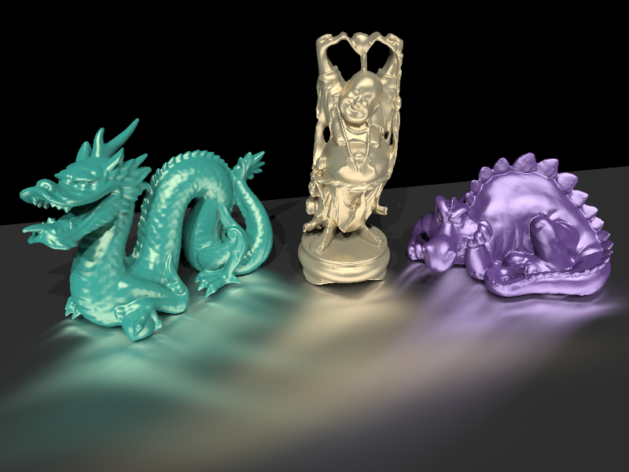
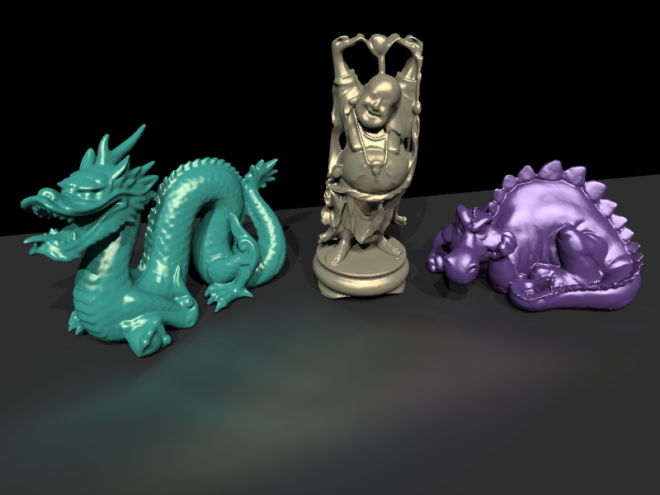

Results: Anisotropic Tableau
Difficult case
Standard VPLs capture almost no indirect illumination
Path tracing:
2.2 hours (8 cores)
Clamped VPLs:
32 sec (GPU) – 1000 lights
New VSLs:
1 min 44 sec (GPU) – 5000 lights

Slide 36
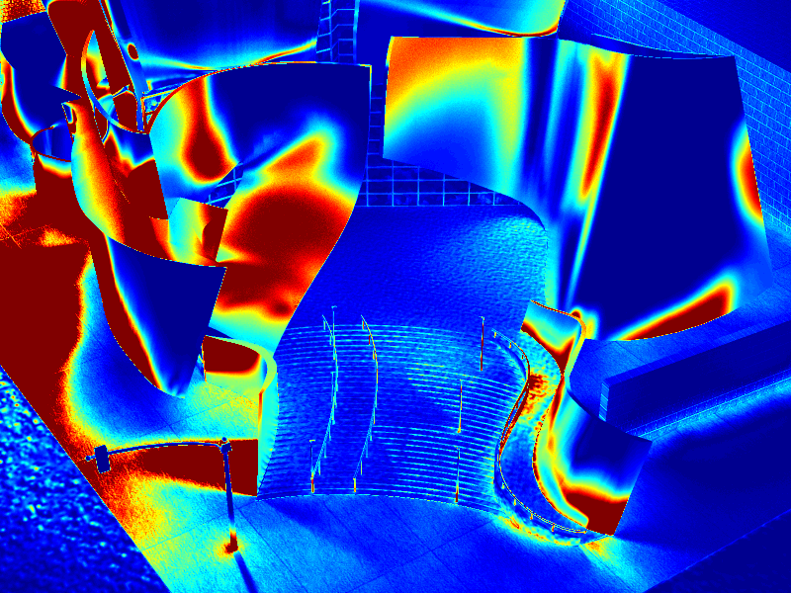
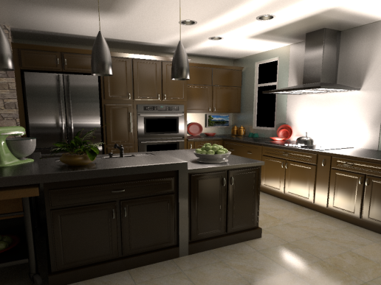
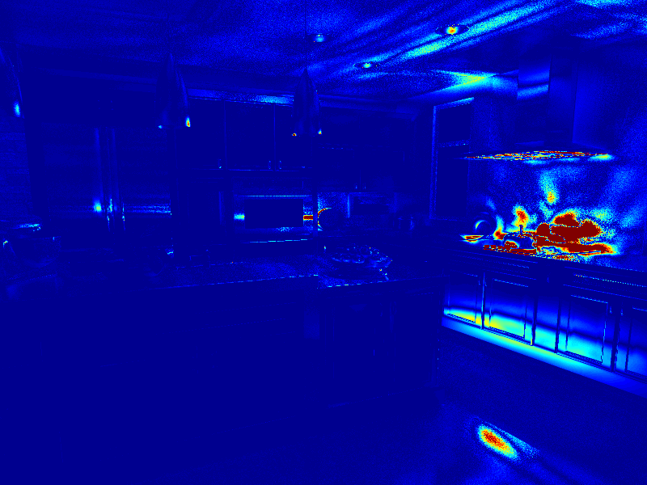
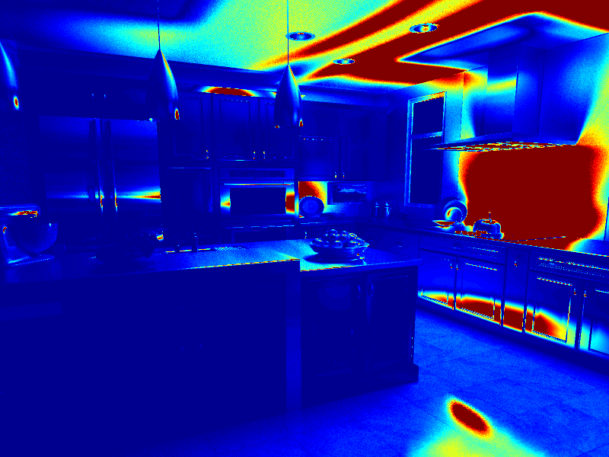
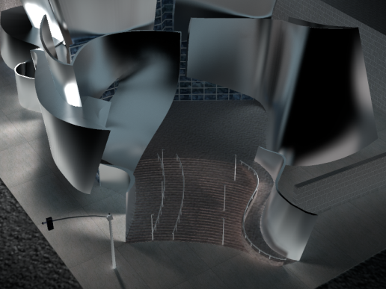
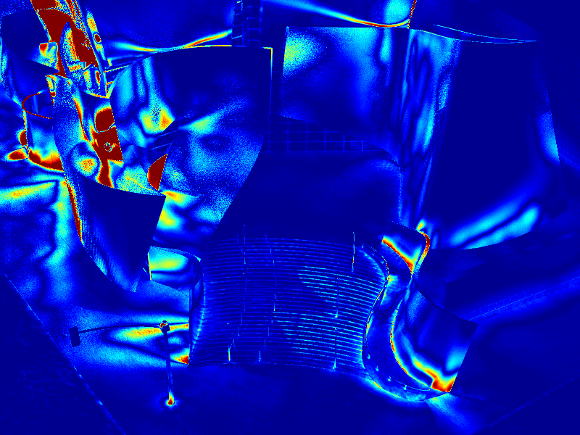
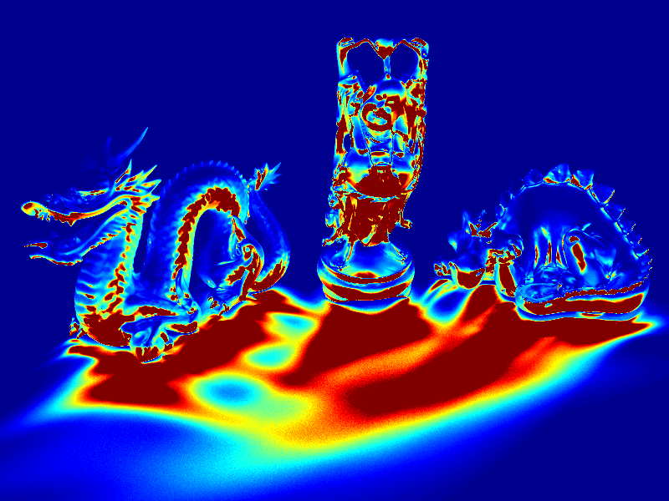
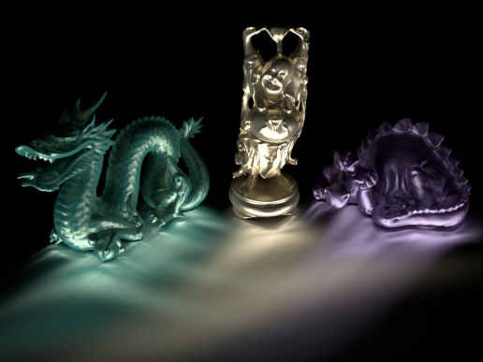
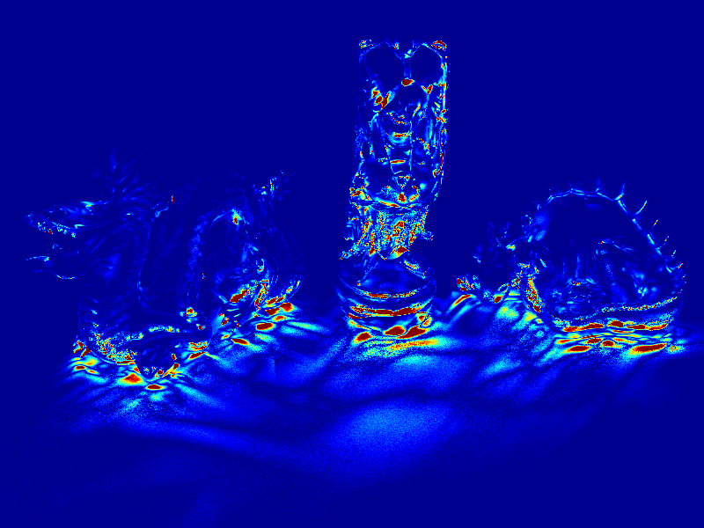
Error Images (Indirect Only)
VPL error
(previous work)
VSL error
(our method)
Ground truth

Slide 37
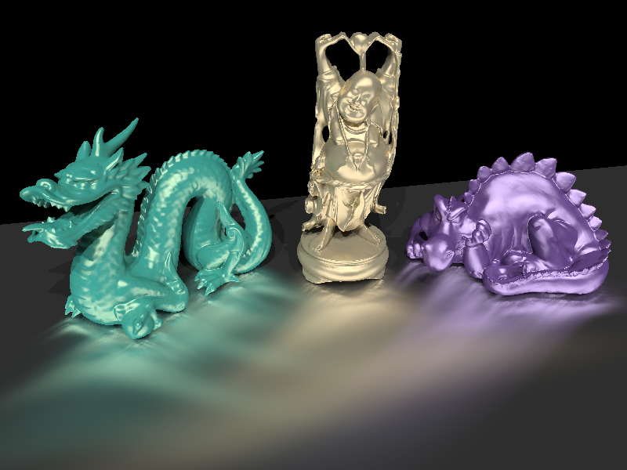
Limitations: Blurring
VSLs can blur illumination
Converges as number of lights increases
5,000 lights - blurred
1,000,000 lights - converged

Slide 38
Other Limitations
Some remaining corner darkening
Computation overhead

Slide 39
Conclusion
Virtual Spherical Lights
  No spikes, no clamping necessary
  Address illumination loss
Many-light methods + VSLs:
  A step to solve the glossy inter-reflection problem
Future Work
  More lights: improve scalability

Slide 40
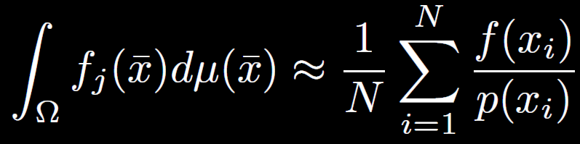
The Problem, Numerically
Recall: Integration over paths, use Monte Carlo
The contribution f(x_{i}) contains:
  Inverse distance-squared term
  Material term at surface location
  Material term at VPL location
What if f(x_{i}) becomes locally large?
  “Spikes”

Slide 41
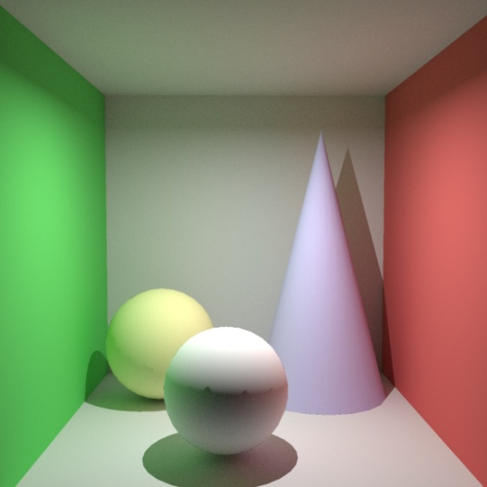
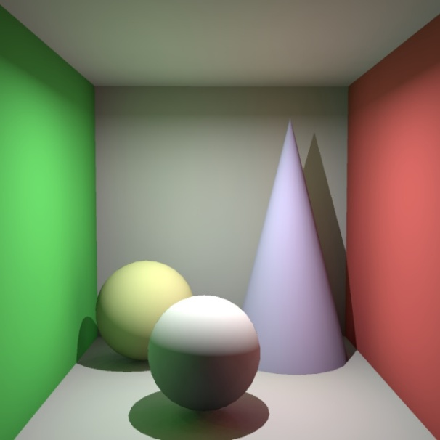
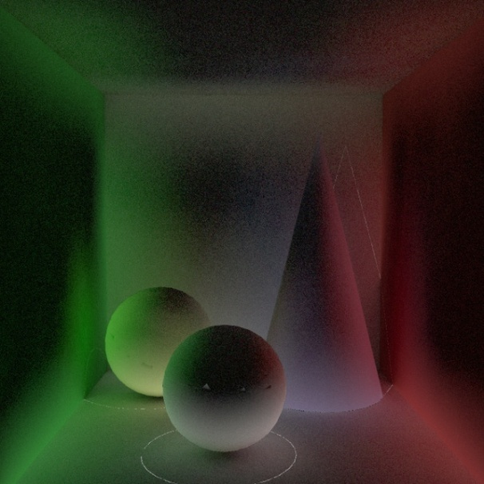
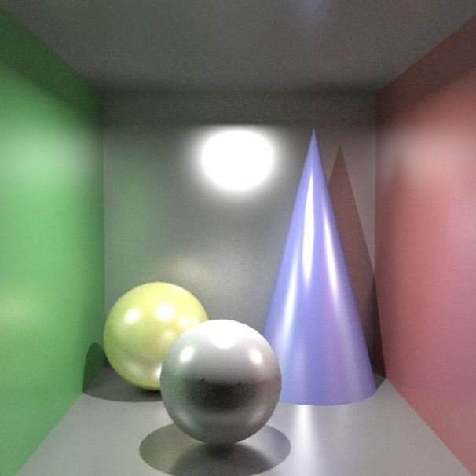
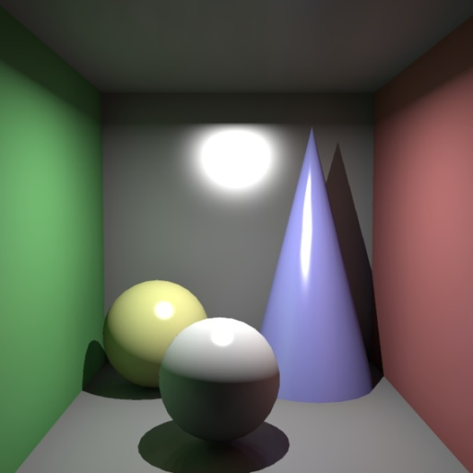
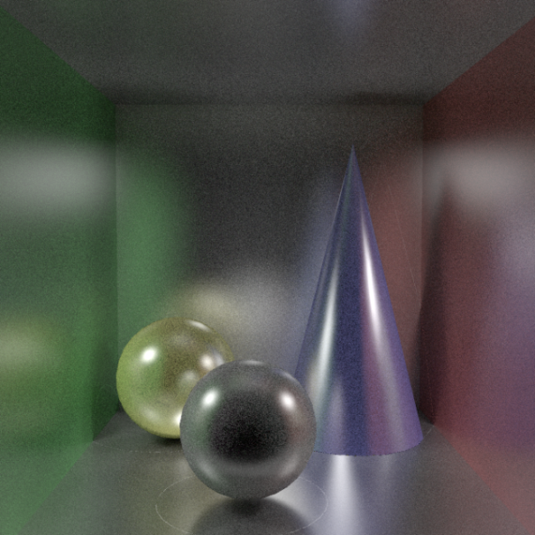
The Problem Revision
Path tracer
Instant radiosity
Difference image

Slide 42
Another Example
Path tracer
Instant radiosity
Difference image

Slide 43
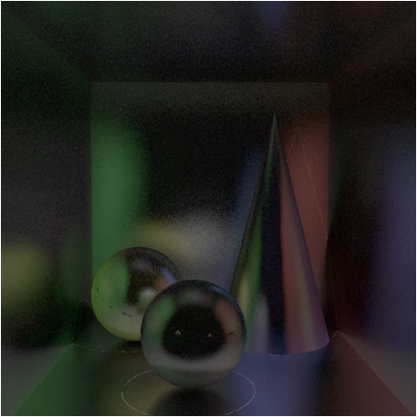

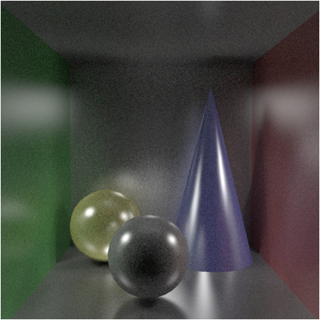
The Missing Components
Missing due to clamping
Missing due to diffuse VPLs
Missing energy

